Slide 1
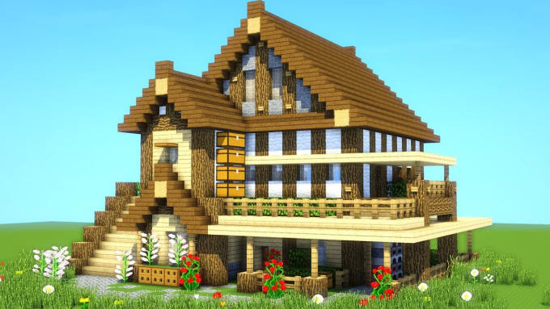
Parts and objects of the house
Partes y objetos de la casa

Slide 2
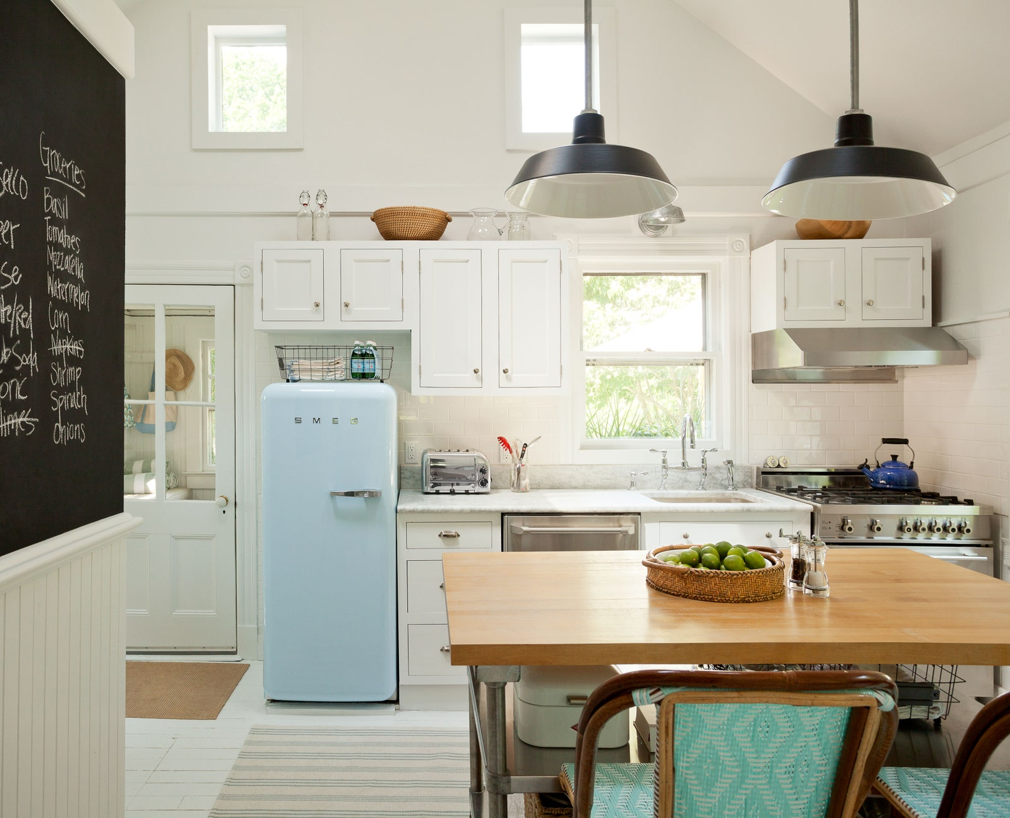
Kitchen: cocina
Microwave: microondas
Fridge: refrigerador
Oven: Horno
Sink: Lavabo

Slide 3
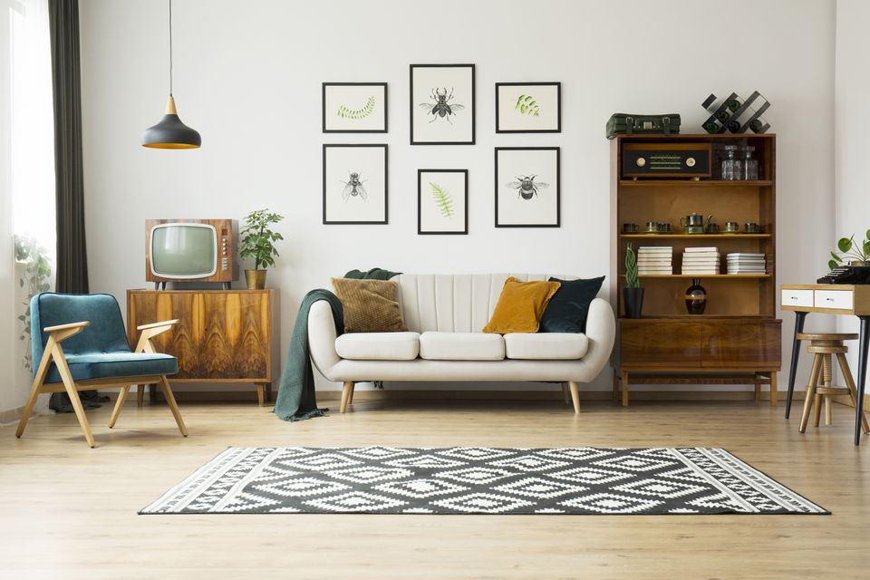
Living room: Sala de estar
Sofa: sillón
TV: televisión
Carpet: alfombra
Rug: alfombra

Slide 4
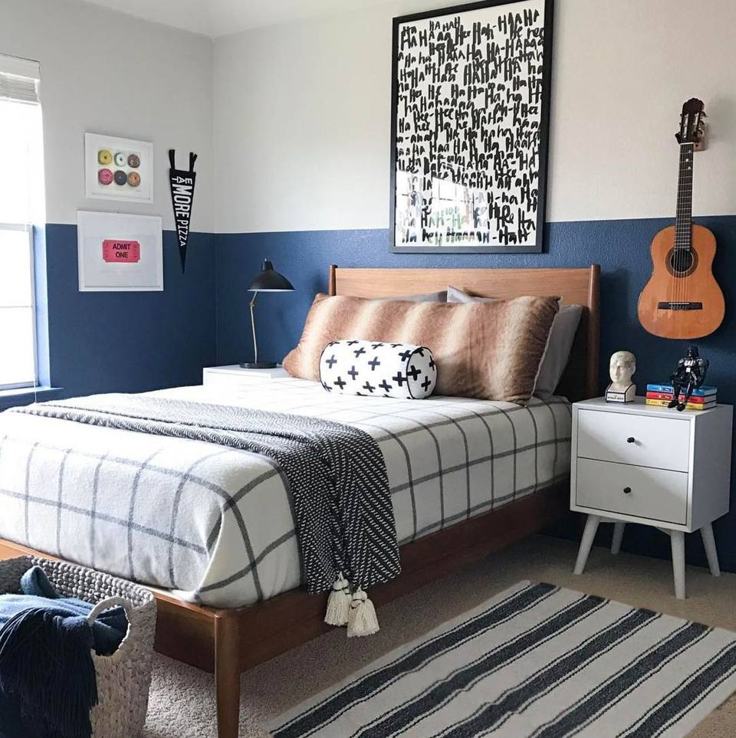
Bedroom: Dormitorio
Bed: cama
Bedside table: velador
Lamp: lampara
Curtain: Cortina

Slide 5
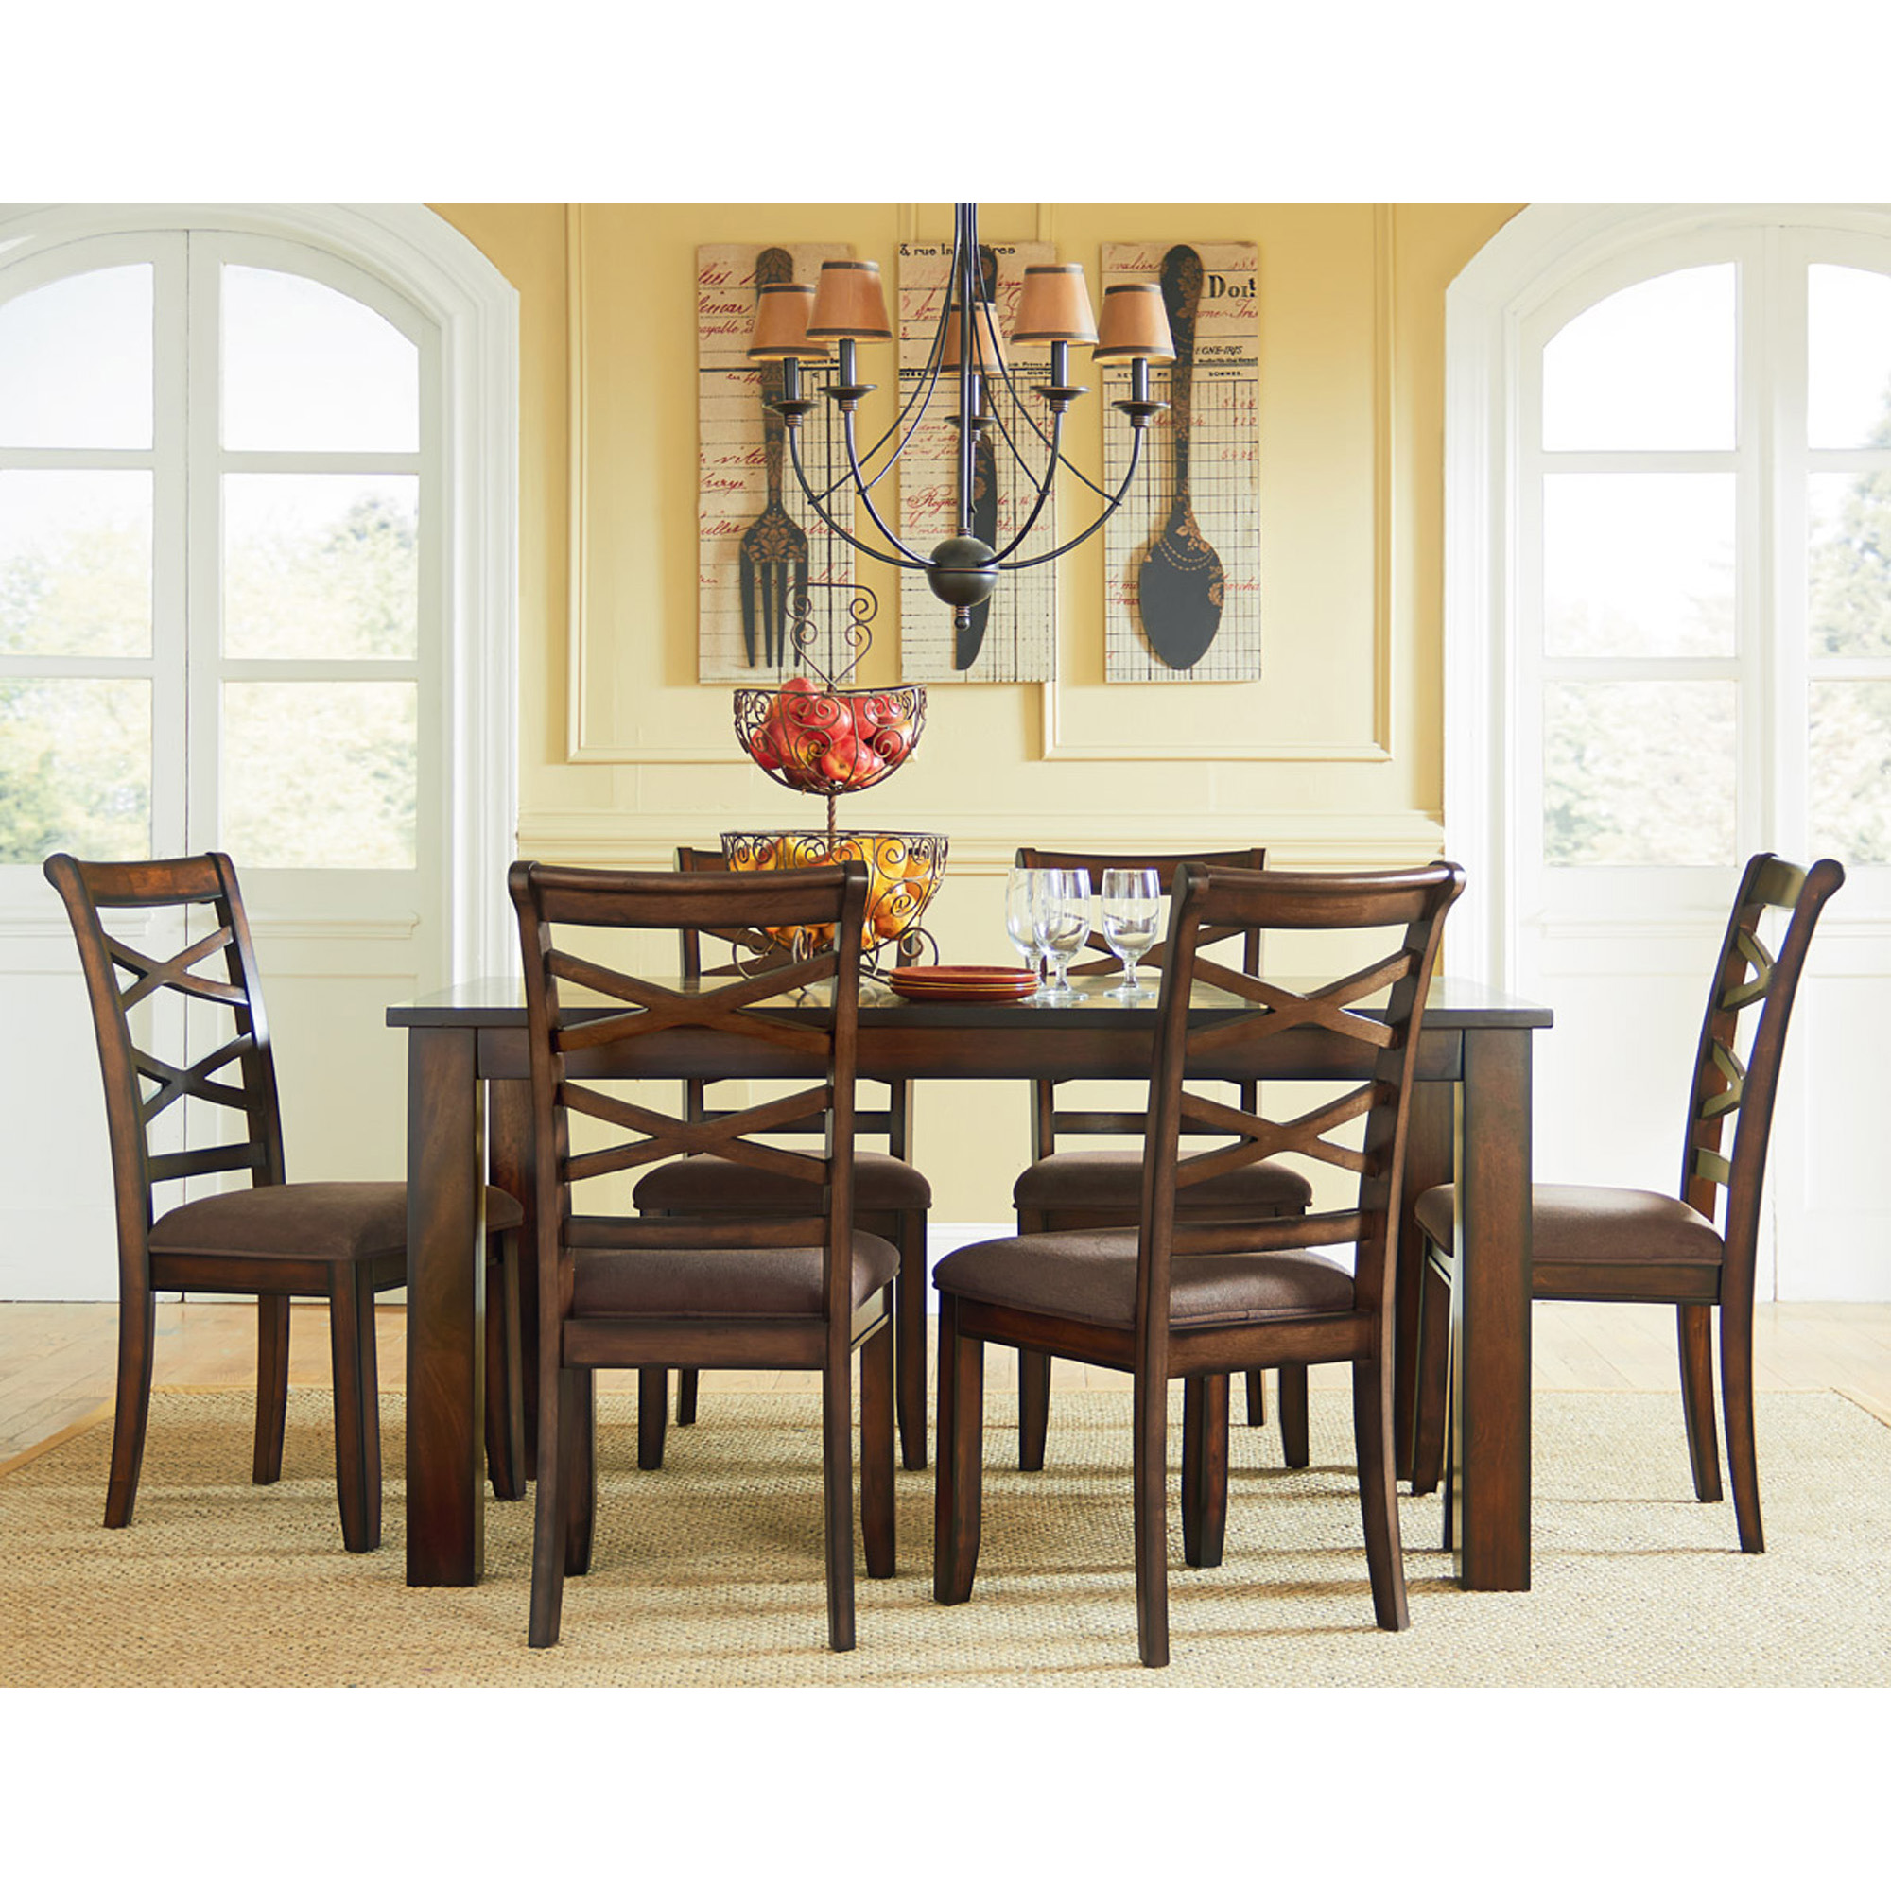
Dining room: COmedor
Chair: silla
Table: mesa
Picture: cuadro

Slide 6
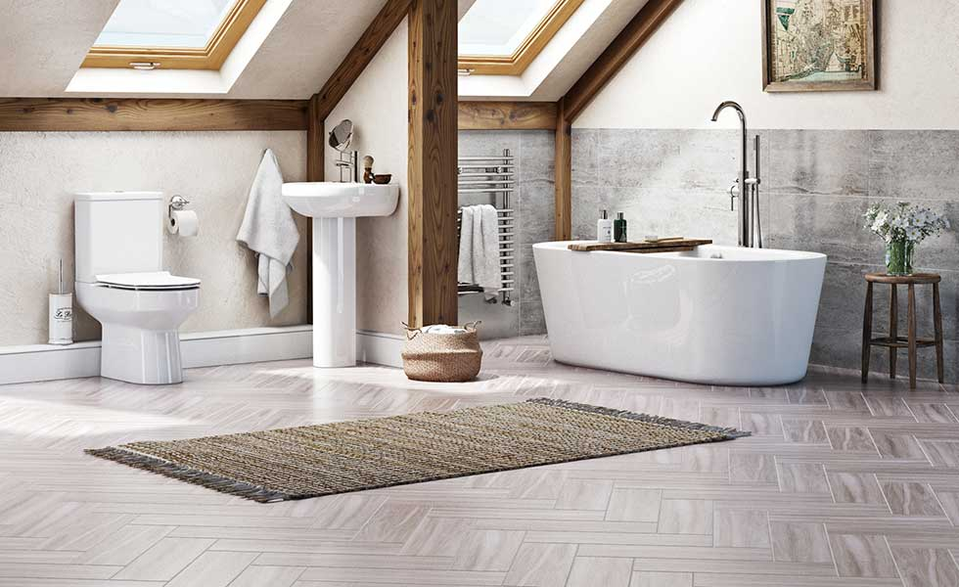
Bathroom: baño
Bath: tina
Shower: ducha
Sink: lavabo
Toilet: baño

Slide 7
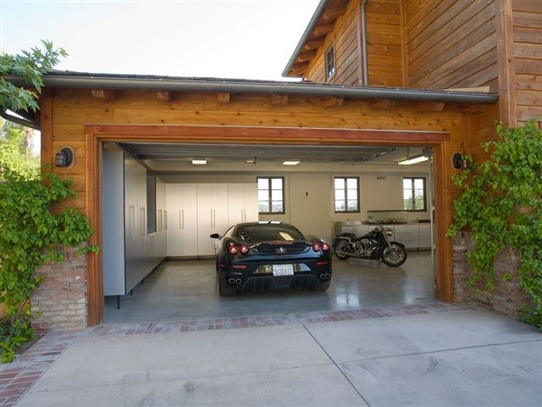
Garage: garaje
Car: auto
Motorbike: motocicleta

Slide 8
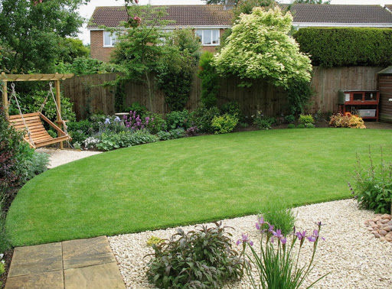
Garden: Jardin
Trees: árboles
Flowers: flores

